Slide 1
A whole new world
Lee Ferridge
Head of Multi-Asset Strategy, The Americas
lsferridge@statestreet.com
December 2024

Slide 2
The here and now

Slide 3
The economy is slowing, a bit
There are pockets of weakness, but also strength
Manufacturing is in decline
And so are job openings
Source: State Street Global Markets, Bloomberg; data as of 12/06/2024

Slide 4
But core inflation has stopped falling
Still believe we are going to continue to decline?
2% on the way?
Source: State Street Global Markets, Bloomberg, PriceStats; data as of 12/06/2024

Slide 5
And let’s not overplay labour market weakness
Slowing from a high base
Slowing slowly
But wages regathering momentum
Source: State Street Global Markets, Bloomberg; data as of 12/06/2024

Slide 6
Still robust overall
Unemployment still very low historically
Hardly reason to panic
Sahm what?
Source: State Street Global Markets, Bloomberg; data as of 12/06/2024

Slide 7
Where is the recession?
Real wages and spending rising, not falling
Consumers still solid
Recession?
Source: State Street Global Markets, Bloomberg; data as of 12/06/2024

Slide 8
Not all inflation is falling
Services and wages again remain sticky
Still nearly all about goods prices (CPI)
Same story for PCE
Source: State Street Global Markets, Bloomberg; data as of 12/06/2024

Slide 9
Still underlying concerns
Fed said they were watching Supercore
Still elevated
Source: State Street Global Markets, Bloomberg; data as of 12/06/2024

Slide 10
Inflation is not beaten
Fed has to think ahead to 2025
Wage pressure rising again
And so is core inflation
Source: State Street Global Markets, Bloomberg; data as of 12/06/2024

Slide 11
The Trump effect

Slide 12
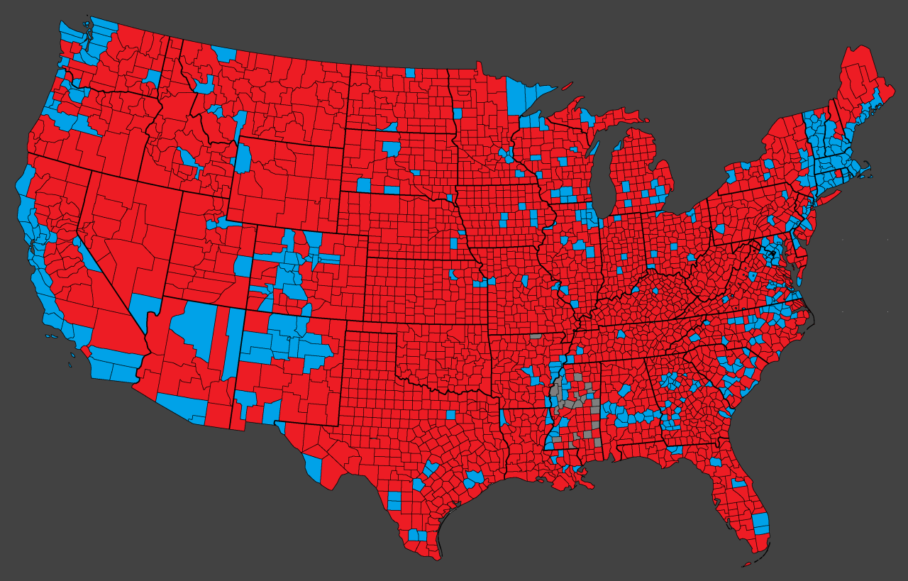
A strong mandate
312:226 Electoral Collage. 77.2m vs 74.9m popular vote
53:47 Senate. 220:215 House
Better coverage than Verizon
VT
NH
MA
MI
CT
Pennsylvania
NJ
IN
N Carolina
S Carolina
MISS
Florida
Source: State Street Global Markets, Mapsontheweb.com; data as of 11/26/2024

Slide 13
Market now more hawkish than the Fed
Trump effect on rates already being seen
In line for this year
But has moved apart for 2025
Source: State Street Global Markets, Bloomberg; data as of 12/06/2024

Slide 14
Issue 1: Immigration
It’s a new era. Workforce is barely going to grow
No growth without immigration
Source: State Street Global Markets, United Nations, Bloomberg; data as of 12/06/2024

Slide 15
Impacting already
Retirements explain the lack of workers
Where are all the people?
They retired
Source: State Street Global Markets, Bloomberg; data as of 12/06/2024

Slide 16
Not a strong bench
Lack of workers set to persist
Working age population is working
But no immigration = no growth in workers
Source: State Street Global Markets, Bloomberg, BLS; data as of 12/06/2024

Slide 17
Already falling?
The workforce would already be declining without immigration
Trends going the wrong way for growth
Source: State Street Global Markets, TRAC, Bloomberg; data as of 12/06/2024

Slide 18
It’s simply supply and demand
Lower demand for workers needed
From excess supply to excess demand
Worker shortage = stubborn wages
Source: State Street Global Markets, Bloomberg; data as of 12/06/2024

Slide 19
Issue 2: Fiscal
We now have structurally higher deficits
Structurally bigger deficits from here
CBO Forecasts
Source: State Street Global Markets, Congressional Budget Office; data as of 12/06/2024

Slide 20
And it won’t get better
8% average incoming?
Bigger either way
Source: State Street Global Markets, Penn Wharton; data as of 12/06/2024

Slide 21
Issue 3: The Balance Sheet
Structurally larger than needed, likely to stay that way
A long way to go to “normal”
Source: State Street Global Markets, United Nations, Bloomberg; data as of 12/06/2024

Slide 22
Why it matters
Are rates restrictive?
Not at the long end
That’s why financial conditions are loose
Source: State Street Global Markets, Bloomberg, NY Federal Reserve; data as of 12/06/2024

Slide 23
So where are we going?

Slide 24
Where is neutral?
The Fed is at 2.875% now, market has moved higher
Rising consistently now
But market now bottoming around 3.5%
Source: State Street Global Markets, Bloomberg; data as of 12/06/2024

Slide 25
Moving higher
Trump impact clear, but was happening even before the election
Cycle low has moved sharply higher
All across the strip
2024
2025
Source: State Street Global Markets, Bloomberg; data as of 12/06/2024

Slide 26
Longer-term market broadly agrees
Higher than the ‘10s but lower than the ‘90s
Moving higher
Back to the ‘00s or the 90s?
Source: State Street Global Markets, Bloomberg; data as of 12/06/2024

Slide 27
Similar but different

Slide 28
Demographics are an issue everywhere
Labour supply a problem across the DM world
Which means higher wages
And sticky services inflation
Source: State Street Global Markets, Bloomberg; data as of 12/06/2024

Slide 29
Immigration policy is key
Faster growth with lower inflation will require overseas workers
Slower growth in workers everywhere
But contraction with no immigration
Source: State Street Global Markets, United Nations, Bloomberg; data as of 12/06/2024

Slide 30
But fiscal policy is diverging
US to stand alone with excessive deficits
US exceptionalism again
Source: State Street Global Markets, Bloomberg; data as of 12/06/2024

Slide 31
The crucial difference
It’s called trend growth for a reason
Few above trend now
And this is expected to continue
Source: State Street Global Markets, Bloomberg; data as of 12/06/2024

Slide 32
US exceptionalism (the good kind)
Significant G10 macro divergence
US out on its own
Source: State Street Global Markets, Bloomberg; data as of 12/06/2024

Slide 33
Still not pricing enough divergence
US seen as middle of the pack, ECB seen as the most dovish from here
Over the next year
And over the next two
Source: State Street Global Markets, Bloomberg; data as of 12/06/2024

Slide 34
Clues from our indicators

Slide 35
Bouncing back
Sentiment strongly positive again after August wobble
Glass had been half full for a while
Source: State Street Global Markets; data as of 12/06/2024

Slide 36
Positivity ingrained
Strong since the summer
Most upbeat in three years
Source: State Street Global Markets; data as of 12/06/2024

Slide 37
All about stocks
Equity weighting still close to highest in 16 years
Concentration risk
Position shake-out being reversed
Source: State Street Global Markets; data as of 12/06/2024

Slide 38
Concentration risk
Investors are overweight equities, and breadth an increasing concern
Concentration risk pt. 1
Concentration risk pt. 2
Source: State Street Global Markets; data as of 12/06/2024

Slide 39
But it can last
Excess liquidity underpins the equity favouritism
Overweight stocks for a while
Liquidity the reason
Source: State Street Global Markets; data as of 12/06/2024

Slide 40
Dollar positioning a concern?
Overweight largely eradicated
Holdings rebounding
Rebuild = higher dollar
Source: State Street Global Markets, Bloomberg; data as of 12/06/2024

Slide 41
And things are different now
It’s expensive to hedge the USD now
Rate divergence changes the hedge equation
For equities as well
Source: State Street Global Markets; data as of 12/06/2024

Slide 42
What about FX positioning now?
Dollar overweight not extensive
Room to build back up?
Source: State Street Global Markets; data as of 12/06/2024

Slide 43
How to trade it

Slide 44
2025 moves pared back
From six cuts to three
All the way back to zero?
Source: State Street Global Markets, Bloomberg; data as of 12/06/2024

Slide 45
Curve steepener? Which part?
Got to play the fly
2s5s could start to invert again
But fiscal concerns at the long end will grow
Source: State Street Global Markets, Bloomberg; data as of 12/06/2024

Slide 46
What’s driving the USD?
All about rates
2-yr yields have been key for a while
But 10-yr now the focus
Source: State Street Global Markets, Bloomberg; data as of 12/06/2024

Slide 47
Rate expectations further to go and so has the USD
Reduced overweight, relative rates turning
Vs. the EUR
And GBP
Source: State Street Global Markets, Bloomberg; data as of 12/06/2024

Slide 48
Rate expectations the FX key
US easing overplayed
Vs. the JPY
And CAD
Source: State Street Global Markets, Bloomberg; data as of 12/06/2024

Slide 49
EM the party is over
Carry had a good run, caution required now
Had become increasingly idiosyncratic
Source: State Street Global Markets, Bloomberg; data as of 12/06/2024

Slide 50
Disclaimers and Important Risk Information [2024.01]
This communication is provided only to professional clients or eligible counterparties or their equivalent by State Street Bank and Trust Company or, where applicable and permissible, its bank and non-bank affiliates (“State Street”). State Street Bank and Trust Company is authorized and regulated by the Federal Reserve Board, registered with the Commodity Futures Trading Commission as a Swap Dealer, and is a member of the National Futures Association. State Street Bank International GmbH (“SSBI”) is regulated by the European Central Bank (“ECB”), the German Federal Financial Supervisory Authority (“BaFin”) and the Deutsche Bundesbank. Details about the extent of SSBI’s regulation by the ECB, the BaFin and Deutsche Bundesbank are available from us on request. Products and services described herein may not be available in all jurisdictions or through all State Street entities. Activities described herein may be conducted from offshore. Information provided is of a general nature only and has not been reviewed by any regulatory authority.
This communication is intended for general marketing purposes, and the information contained herein has not been prepared in accordance with legal requirements designed to promote the independence of investment research. It is for clients to determine whether they are permitted to receive research of any nature. Market commentary provided by trading desks is not investment research. This communication is not intended to suggest or recommend any transaction, investment, or investment strategy, does not constitute investment research, nor does it purport to be comprehensive or intended to replace the exercise of an investor’s own careful independent review and judgment regarding any investment decision.
This communication is not intended for retail clients, nor for distribution to, and may not be relied upon by, any person or entity in any jurisdiction or country where such distribution or use would be contrary to applicable law or regulation. This communication or any portion hereof may not be reprinted, sold or redistributed without the prior written consent of State Street. This communication and the information herein does not constitute investment, legal, or tax advice and is not a solicitation to buy or sell securities or any financial instrument nor is it intended to constitute a binding contractual arrangement or commitment by State Street of any kind. The information provided does not take into account any particular investment objectives, strategies, investment horizon or tax status.
The views expressed herein are the views of State Street as of the date specified and are subject to change, without notice, based on market and other conditions. The information provided herein has been obtained from sources believed to be reliable at the time of publication, nonetheless, we make no representations or assurances that the information is complete or accurate, and you should not place any reliance on said information. State Street hereby disclaims any warranty and all liability, whether arising in contract, tort or otherwise, for any losses, liabilities, damages, expenses or costs, either direct, indirect, consequential, special, or punitive, arising from or in connection with any use of this document and/or the information herein.
State Street may from time to time, as principal or agent, for its own account or for those of its clients, have positions in and/or actively trade in financial instruments or other products identical to or economically related to those discussed in this communication. State Street may have a commercial relationship with issuers of financial instruments or other products discussed in this communication.
This communication may contain information deemed to be forward-looking statements. These statements are based on assumptions, analyses and expectations of State Street in light of its experience and perception of historical trends, current conditions, expected future developments and other factors it believes appropriate under the circumstances. All information is subject to change without notice.
Participating in trading any financial instrument, including but not limited to foreign exchange, equities, futures, fixed income or derivative instruments, or investments in non-liquid or emerging markets, or digital assets, or participating in securities lending, repurchase transactions or other collateral services present risks, which may include but are not limited to counterparty, collateral, investment loss, tax, and accounting risks. Where applicable, returns may increase or decrease as a result of currency fluctuations. Derivatives may be more volatile than the underlying instruments. Certain foreign exchange business, including spot and certain forward transactions, may not be regulated in all jurisdictions. Past performance is no guarantee of future results.
Please contact your State Street representative for further information.
To learn how State Street looks after your personal data, visit: https://www.statestreet.com/utility/privacy-notice.html.
© 2024 State Street Corporation – All Rights Reserved
Global Markets Research Disclaimer Supplement [2024.01] Australia: This communication is provided to wholesale clients by State Street Bank and Trust Company (Australian Business Number 70 062 819 630, Australian Financial Services License 239679). Brazil: The products in this marketing material have not been and will not be registered with the Comissão de Valores Mobiliários - the Brazilian Securities and Exchange Commission ("CVM"), and any offer of such products is not directed to the general public within the Federative Republic of Brazil ("Brazil"). The information contained in this marketing material is not provided for the purpose of publicly soliciting investments from investors residing in Brazil and no information in this marketing material should be construed as a public offering or unauthorized distribution of the products within Brazil, pursuant to applicable Brazilian law and regulations. Israel: State Street Bank and Trust Company is not licensed under Israel’s Regulation of Investment Advice, Investment Marketing and Portfolio Management Law, 1995. This communication may only be distributed to or used by investors in Israel which are “eligible clients” as listed in the First Schedule to Israel’s Regulation of Investment Advice, Investment Marketing and Portfolio Management Law 1995. Japan: This communication is made available in Japan by State Street Bank and Trust Company, Tokyo Branch, which is regulated by the Financial Services Agency of Japan and is licensed under Article 47 of the Banking Act. Oman: State Street Bank and Trust Company is not a bank or financial services provider registered to undertake business in Oman and is not regulated by the Central Bank of Oman or the Capital Market Authority. Qatar: The information in this communication has not been reviewed or approved by the Qatar Central Bank, the Qatar Financial Markets Authority or the Qatar Financial Centre Regulatory Authority, or any other relevant Qatari regulatory body. Singapore: This communication is made available in Singapore by State Street Bank and Trust Company, Singapore Branch (“SSBTS”), which holds a wholesale bank license by the Monetary Authority of Singapore. In Singapore, this communication is only distributed to accredited, institutional investors as defined in the Singapore Financial Advisers Act 2001 (“FAA”) and its regulations. Note that SSBTS is exempt from Sections 27 and 36 of the FAA. When this communication is distributed to overseas investors as defined in the FAA, note that SSBTS is exempt from Sections 26, 27, 29 and 36 of the FAA. This advertisement has not been reviewed by the Monetary Authority of Singapore. South Africa: State Street Bank and Trust Company is authorized in South Africa under the Financial Advisory and Intermediary Services Act, 2002 as a Category I Financial Services Provider; FSP No. 42671. United Arab Emirates: The information contained within this communication is not intended to lead to the conclusion of any contract of whatsoever nature within the territory of the United Arab Emirates. United Kingdom: State Street Bank and Trust Company is authorised and regulated by the Federal Reserve Board of the United States, authorised by the Prudential Regulation Authority (“PRA”) and subject to regulation by the Financial Conduct Authority and limited regulation by the PRA. Details about the extent of our regulation by the PRA are available from us on request. State Street Bank International GmbH is authorised and regulated by the European Central Bank and the BaFin, deemed authorised by the Prudential Regulation Authority, and subject to regulation by the Financial Conduct Authority and limited regulation by the Prudential Regulation Authority. Details of the Temporary Permissions Regime, which allows EEA-based firms to operate in the UK for a limited period while seeking full authorisation, are available on the Financial Conduct Authority’s website.

